Slide 1
www.netio-products.com

Slide 2
NETIO products overview
Smart power sockets controlled over LAN and WiFi
Jan Rehak
15. 3. 2017

Slide 3
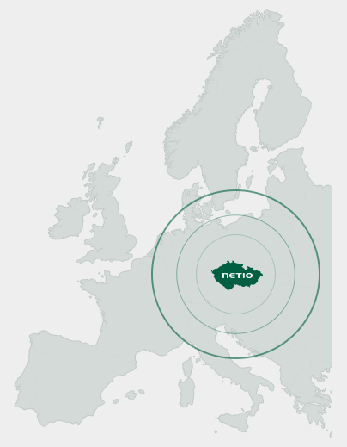
ABOUT NETIO PRODUCTS A.S.
The NETIO products company is a Czech producer of smart power sockets that can be controlled over LAN and WiFi. Our products are programmable and support all common M2M API protocols.
Our sockets are intended mainly for bussines usage (B2B).
A typical user is a SI (System Integrator), uses our products in
various industrial projects.
You can find our power sockets in Industry 4.0 production,
demonstration booths, wind power plants, hospitals,
and many other M2M and IoT applications.

Slide 4
Market segments
Retail in IT market
Final users in IT industry (B2B + B2C).
Needs scheduler, IP WatchDog or similar easy to use functions.
M2M APIs segment
Company which needs reliable and long term stable supplier of power sockets controllable over LAN / WiFi. Project usage, implementation with their software (M2M API) is mandatory.
IoT & Fans - Special project customers
Customer who needs something special (Lua or security).
IoT (Internet of Things) cloud based projects.
Or needs power sockets, which can cooperate with special 3rd party devices (Cisco IP phones, IP cameras, LAN temperature sensors, Access Control, ..)

Slide 5
Products overview
 | NETIO 4All | NETIO 4 | NETIO 4C
Network interface | LAN + WiFi | LAN + WiFi | 2x LAN
WiFi Antenna | RSMA external (3dBi) | Fixed (2dBi) | -
Power Input | Europlug (DE + FR) | Europlug (DE + FR) | IEC320 C13
Power Output | 4x power socket (DE + FR) | 4x power socket (DE + FR) | 4x power socket (DE + FR)
Energy metering | Yes | - | -
Serial port (RS-232) | - | - | Yes
Bluetooth 4.0 LE | Yes | - | -
M2M API protocols | SNMP, HTTP, HTTPs, MQTT, Modbus/TCP, Telnet (SSL), XML, JSON, CGI, SIP
Lua scripting | Yes | Yes | Yes
Mobile App | Yes | Yes | Yes

Slide 6
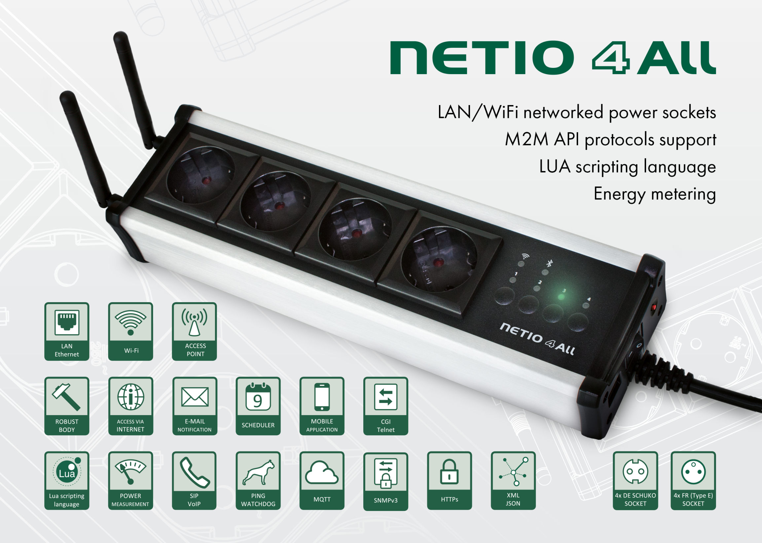

Slide 7
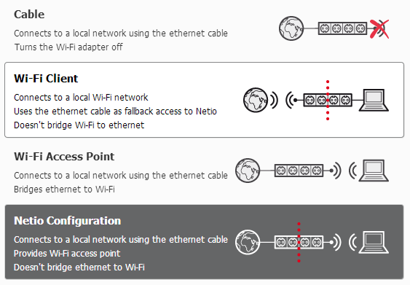
NETIO 4/4All can be WiFi AP (Access Point)
WIFI a,b,g,n
4 different WIFI modes
  Cable
  WiFi Client
  WiFi Access Point
  Netio Configuration
* NETIO 4All = External antenna -3db with RSMA connector

Slide 8
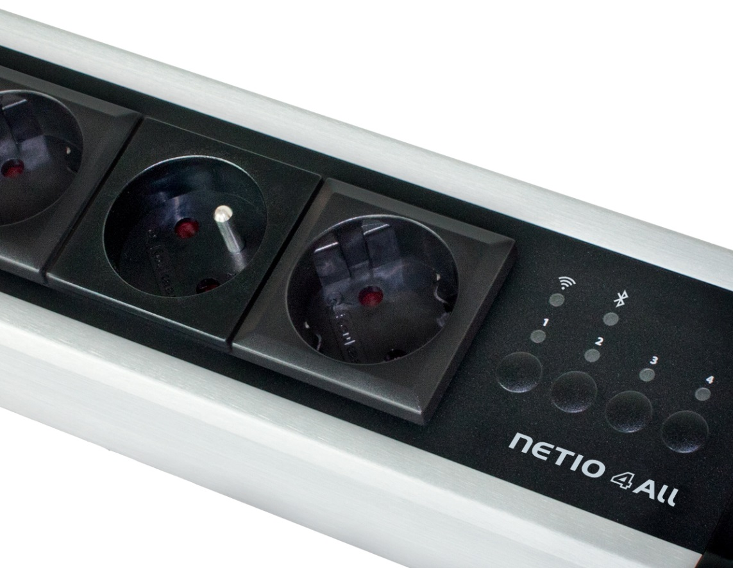
Power meter on NETIO 4All
FR (Type E)
Monitor energy consumption
Each socket measured independently
Alert by email if power consumption
on the socket is too low (Lua)..
Switch On/Off if consumption is
too high or low (Lua)..
DE (Type F - Schuko)

Slide 10
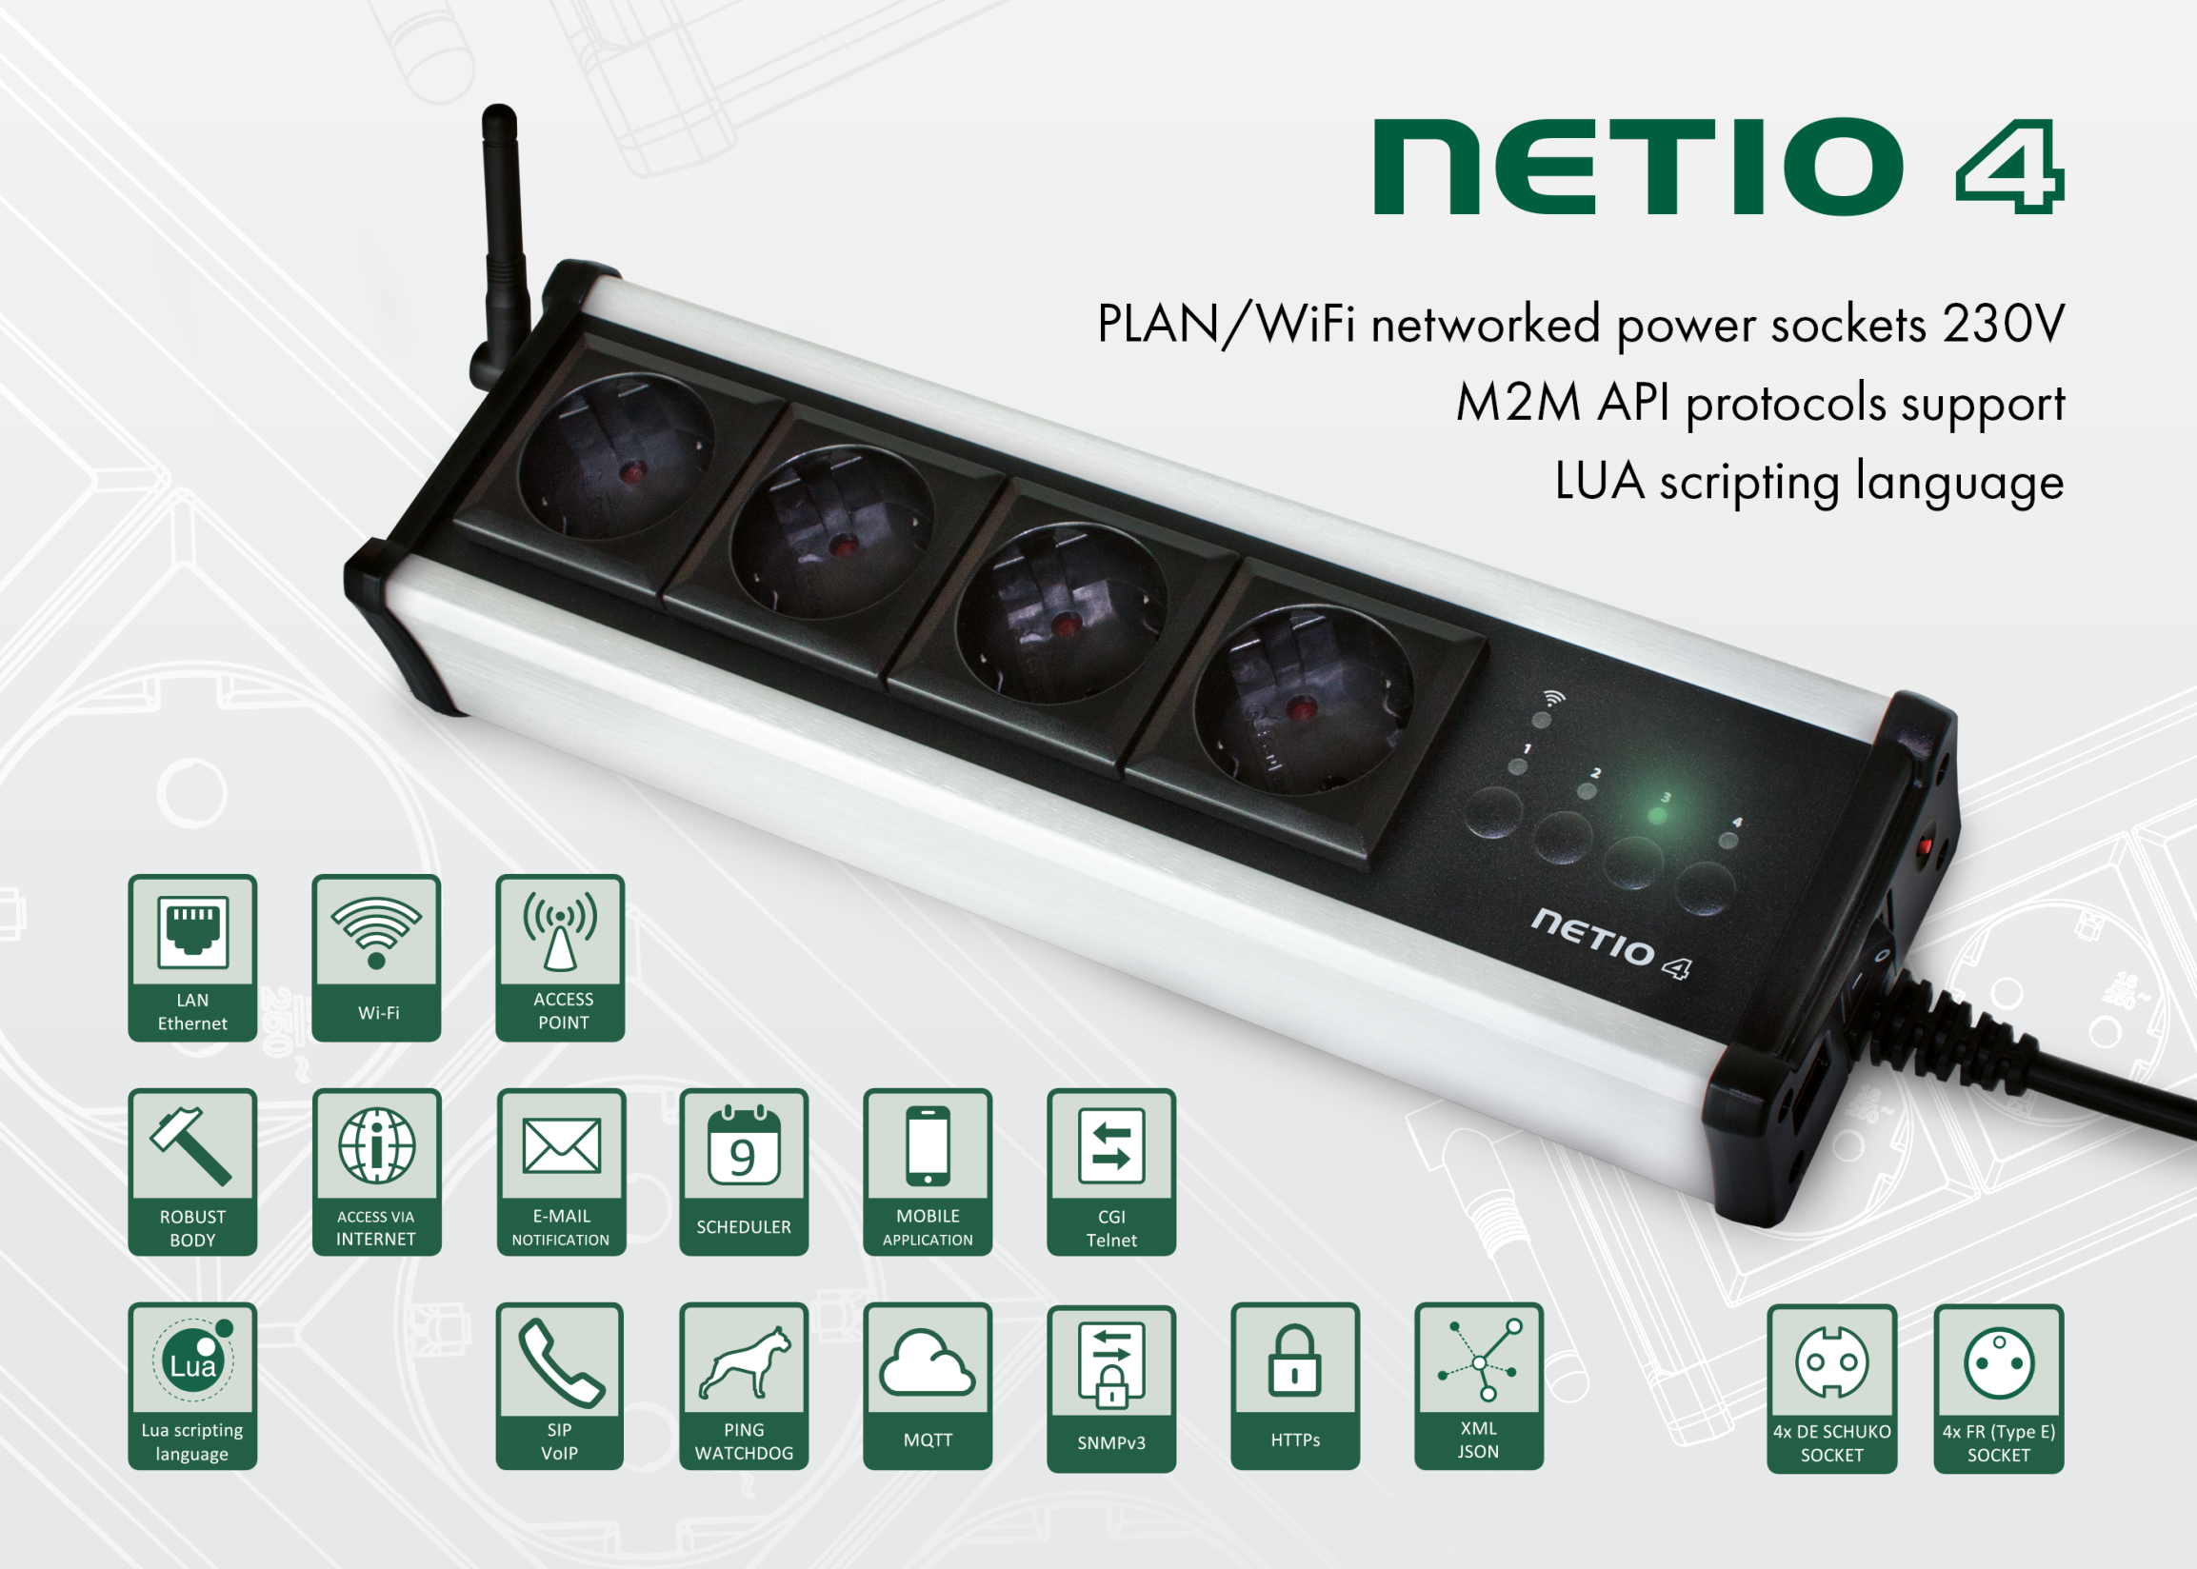

Slide 11
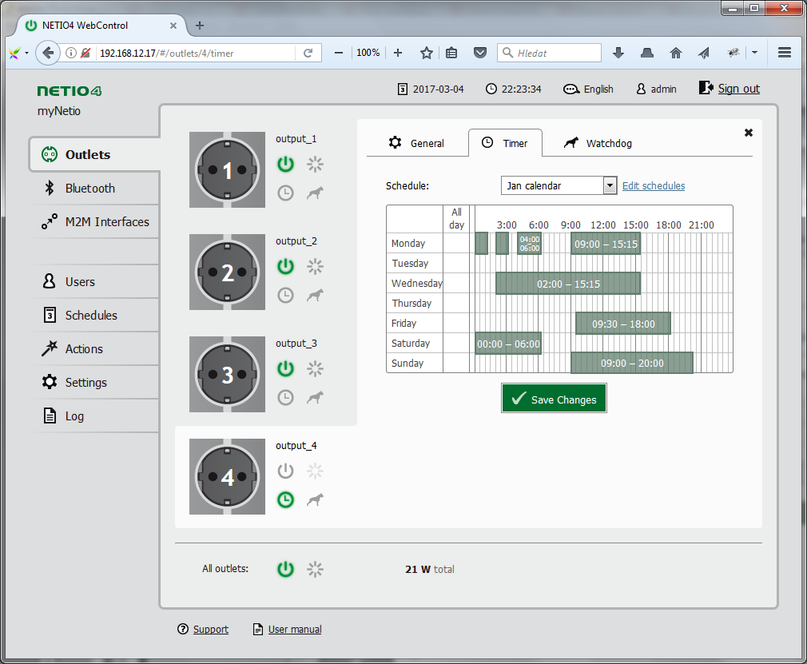
Scheduler
Easy to setup calendar functions
Separated per each power socket
User’s profiles
Graphical user interface

Slide 12
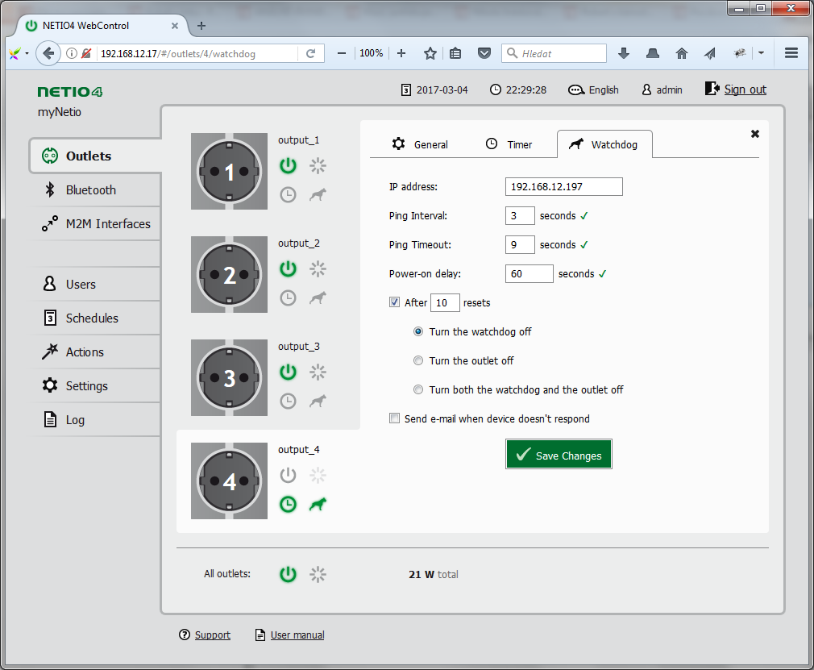
IP Watchdog
Monitor your network devices
Restart your router automatically
Easy to use
Can be extended in Lua

Slide 13
3 products with the same M2M API

Slide 14
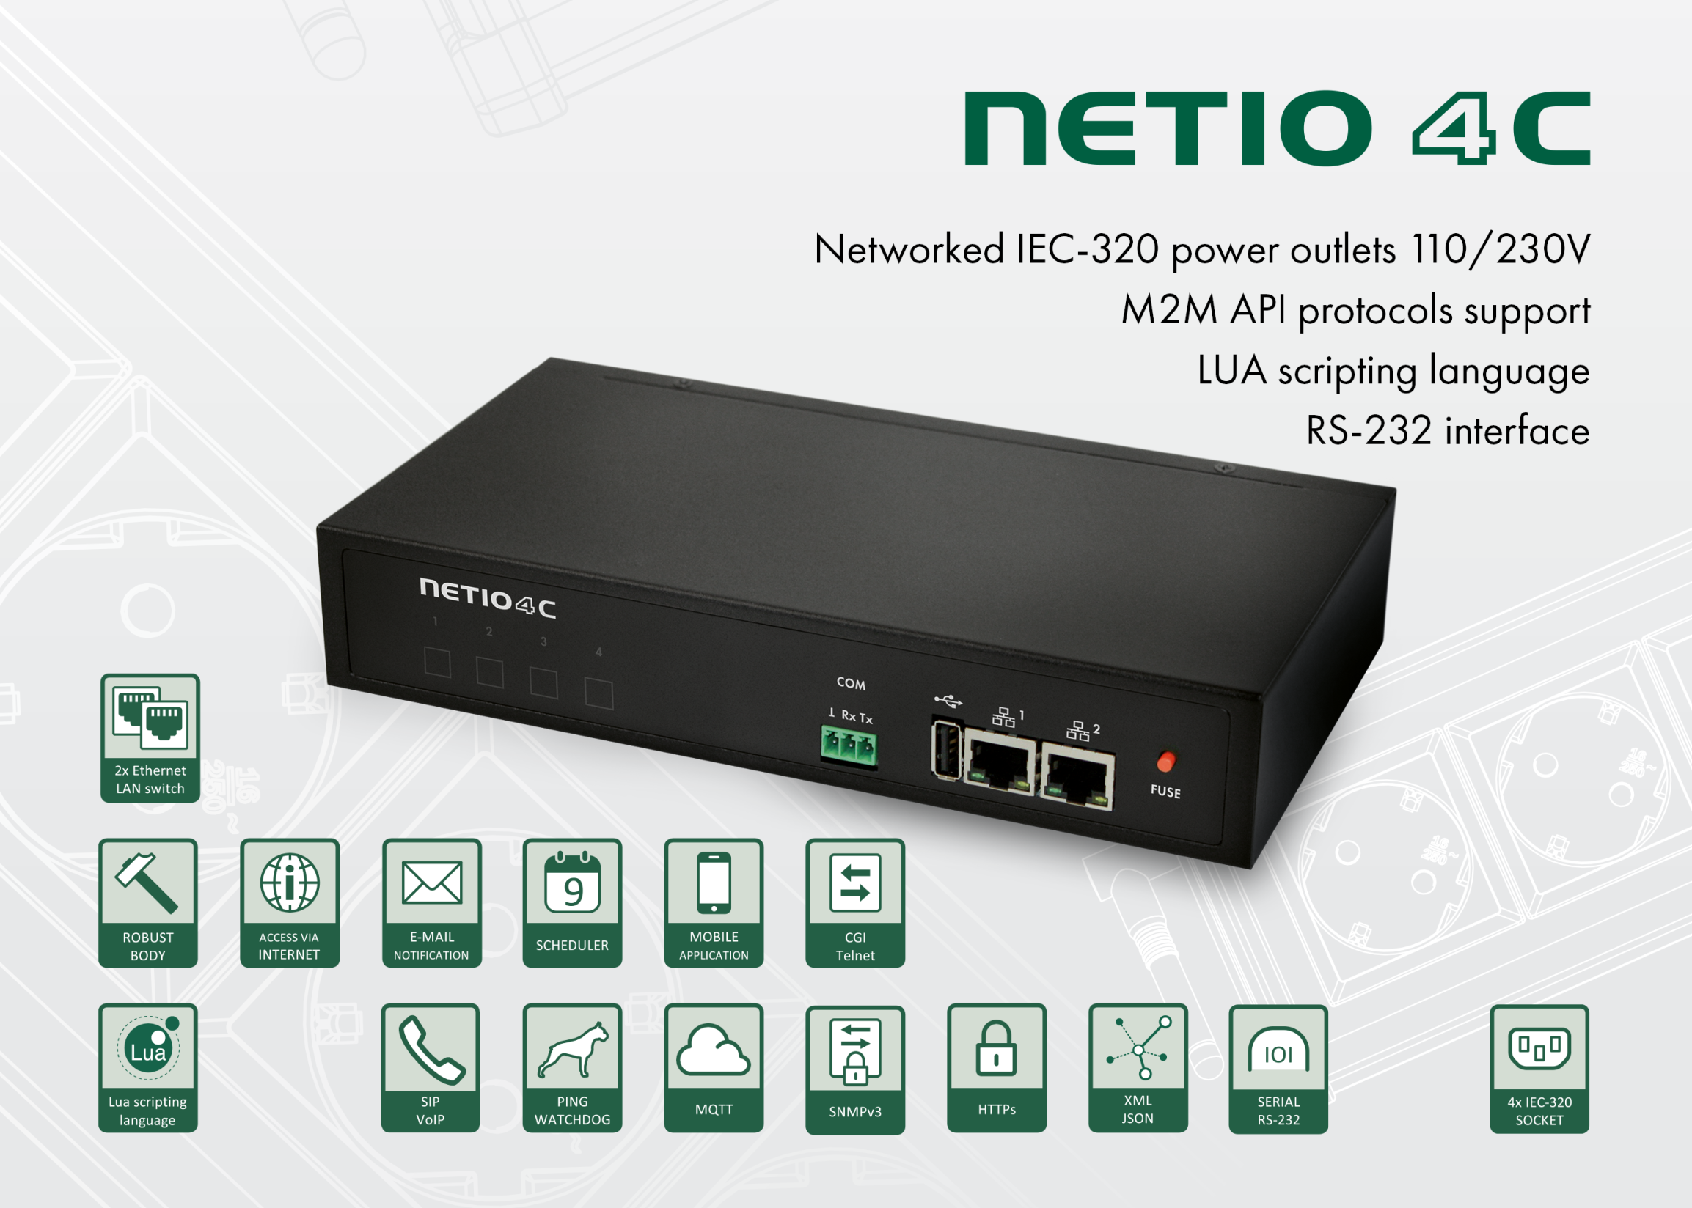

Slide 15
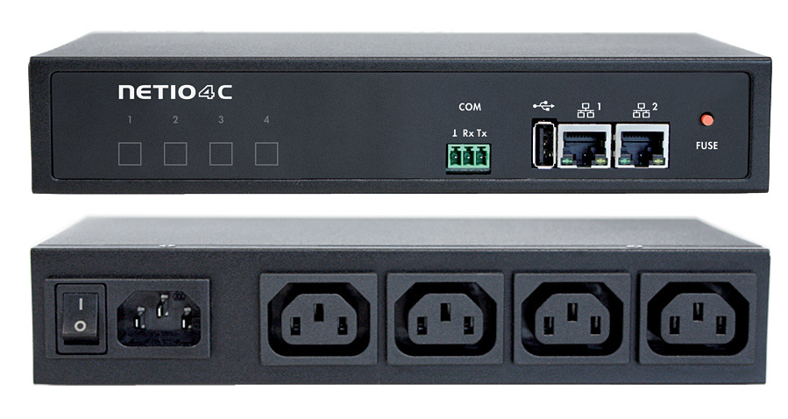

Slide 16
Ethernet Switch / Serial port RS-232
Integrated Ethernet switch
Easy to wire one by one device
Serial port RS-232
Can be used as virtual serial port
Can be controlled by Lua from your scripts (switch ON power socket if something received by serial port)

Slide 18
NETIO Lua scripting
local state = " "
function turnoff()
  for i=1,4 do
    state = devices.system["output" .. i .. "_state"]
    if state == "on" then
        devices.system.SetOut{output=i, value=false}
        logf("Vypinam zasuvku c.%d",i)
    else
      devices.system.SetOut{output=i, value=true}
      logf("Zapinam zasuvku c.%d",i)
    end
  end
end
turnoff()
Write your own script, running in the NETIO 4x power sockets.
Scripting & timing
Ping to defined IP
Read XML from the defined IP
and many more..

Slide 19
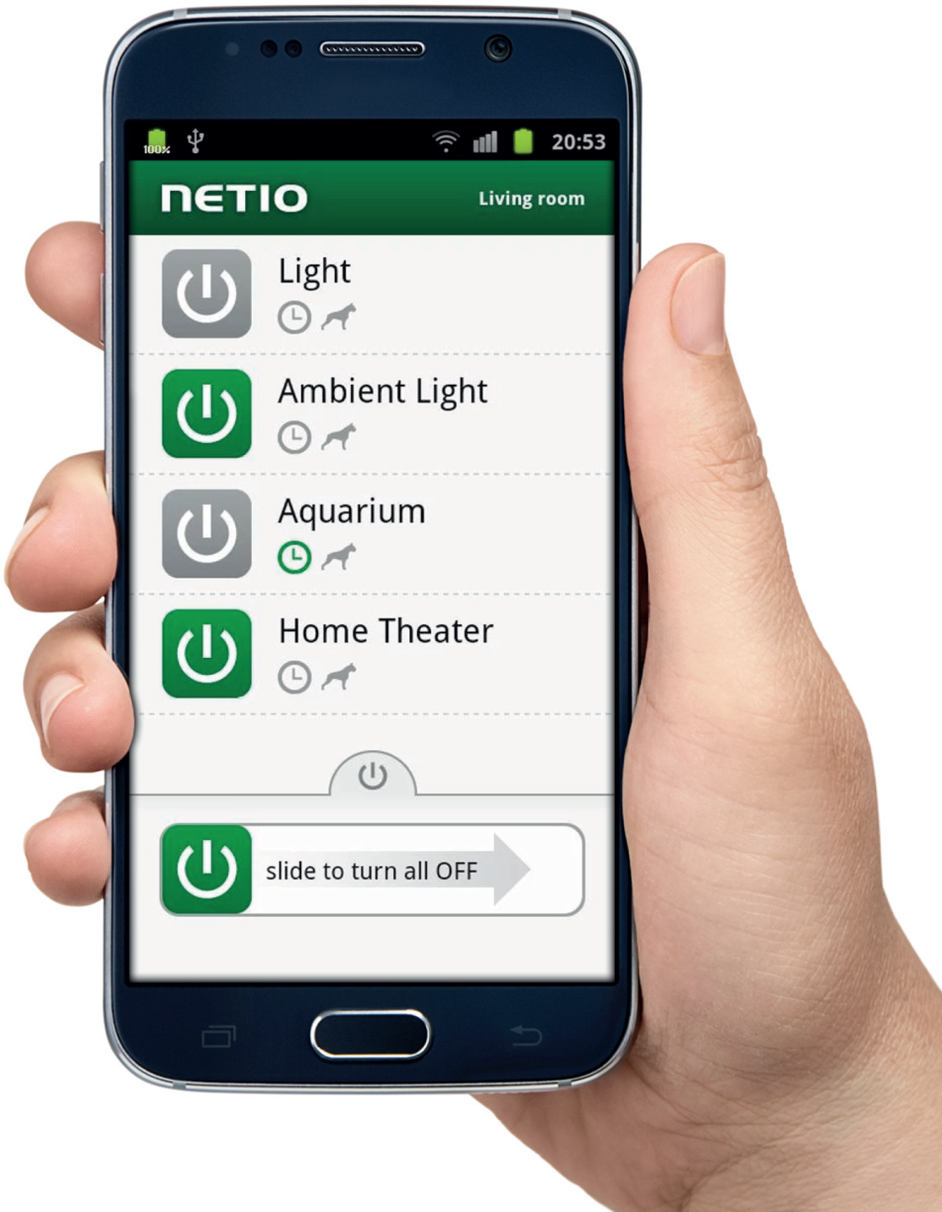
NETIO MOBILE App
Switch the lights, home appliances, routers ... Using mobile phones.
Free download for iOS & Android

Slide 20
Thank you for your attention

